Slide 1


Slide 2
Summer Olympics - EDA
This EDA represents the Data analysis for Summer Olympics history back from 1896 till 2012.
Olympics Hosting
Countries Participation over the Olympics History.
Olympics hosted Cities
Medals :
Top 5 Countries in Olympics History
Trend in medal won count over the years.
Top 3 Countries over the history
Sports and Discipline added over the Years.
Men and Women Performance over the years
Indian Performance in Olympics History
Top 10 Athlete

Slide 3
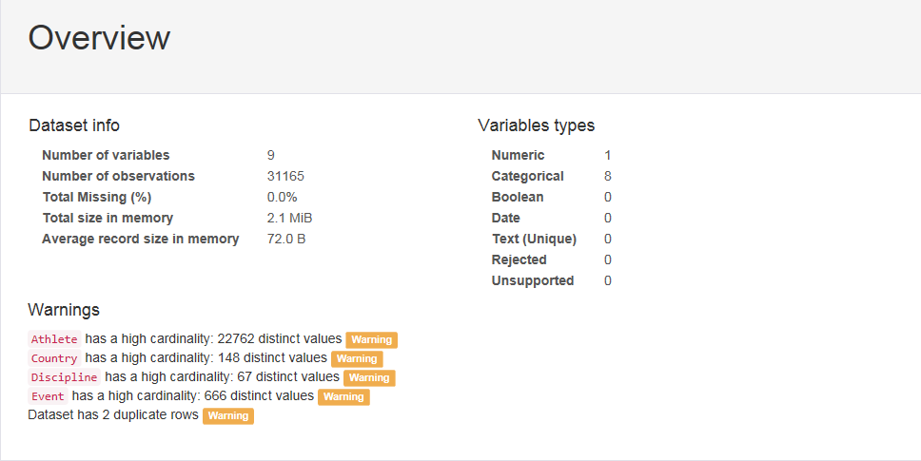
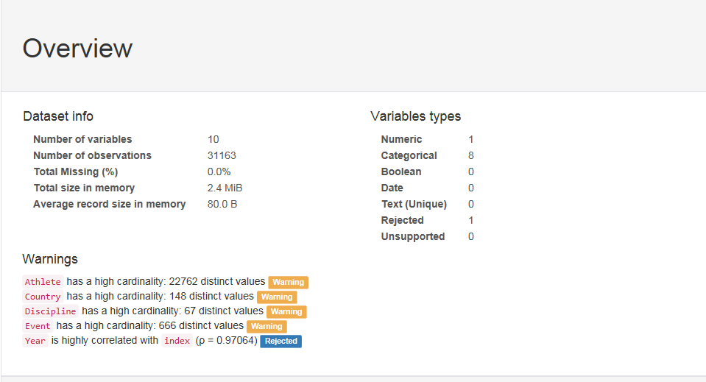
Data Pre-processing

Slide 4
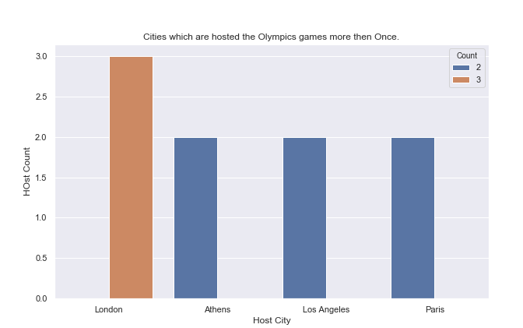
Olympics Hosting City
Four cities had hosted the Olympics games more than ONCE, but London has hosted the Olympics games 3 times.

Slide 5
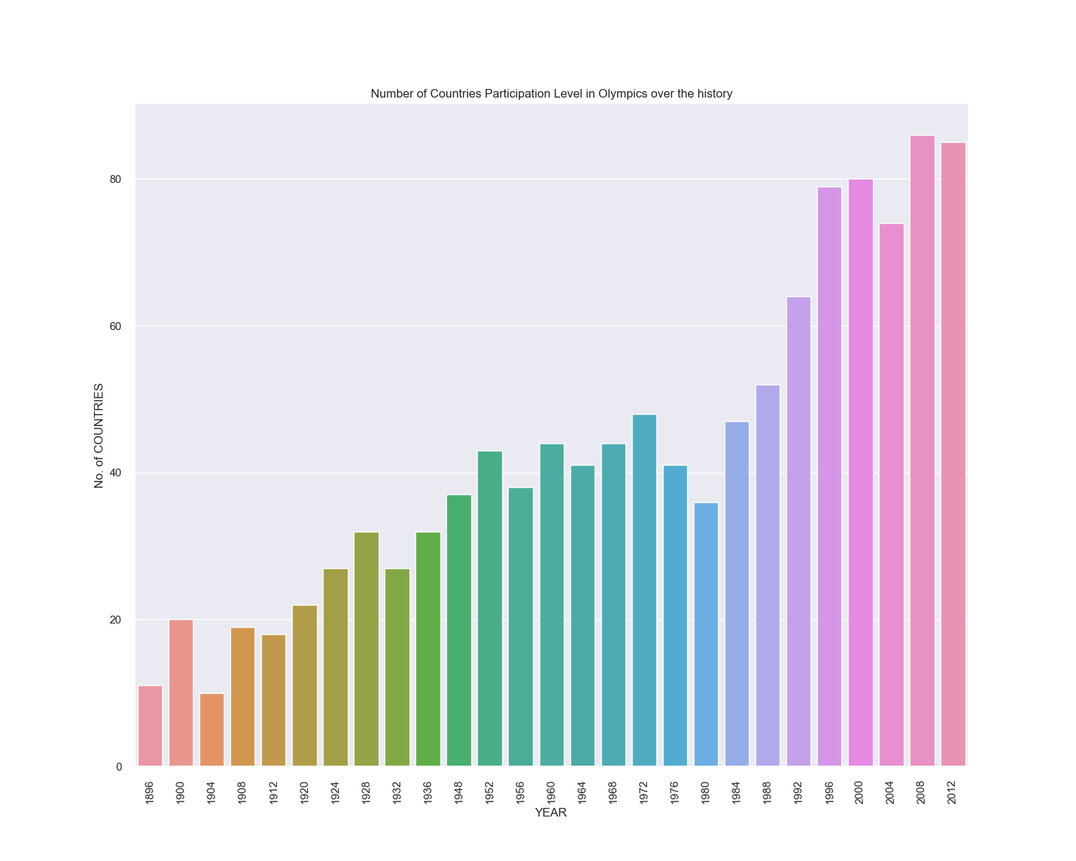
Countries Participation Level in Olympics History

Slide 6
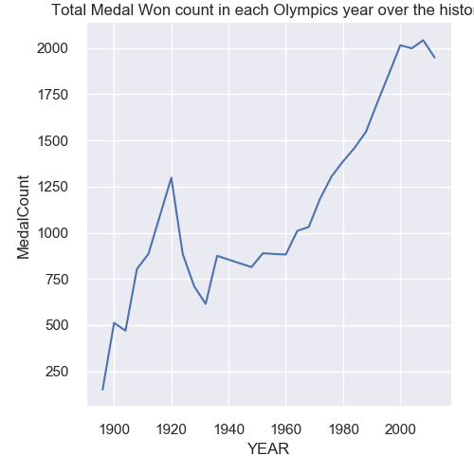
Total Medal Won Count in Olympic History
Overall Positive trend in number of medal won count in each Olympics over the history.
There is steep rise in Medal won in 1920 as 1250 medals and few dips in next 20 years but picking up upward pace from 1960 Olympics onwards.

Slide 7
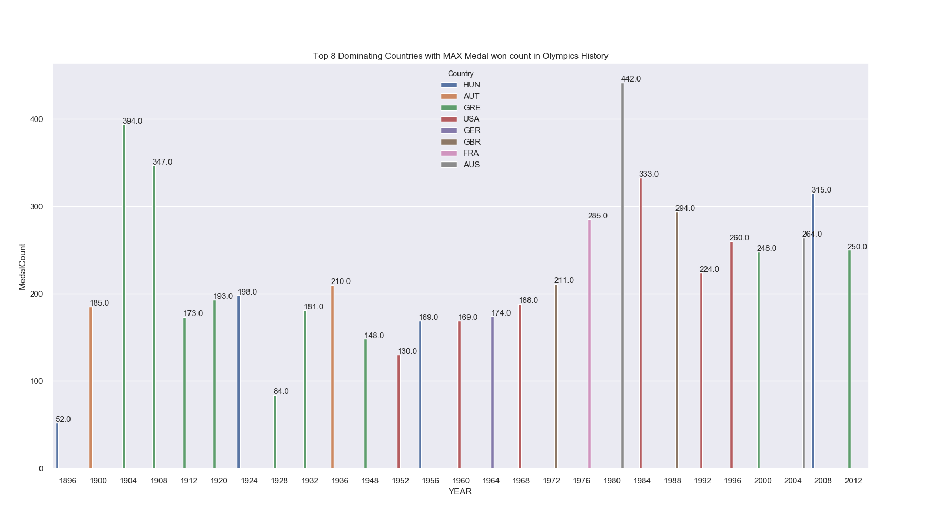

Slide 8
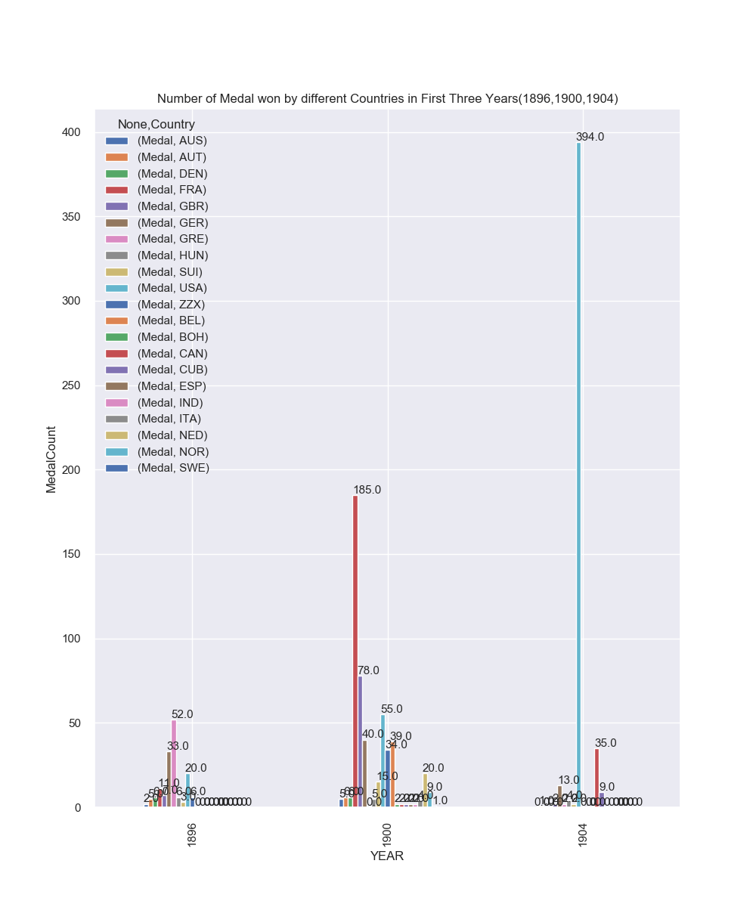

Slide 9
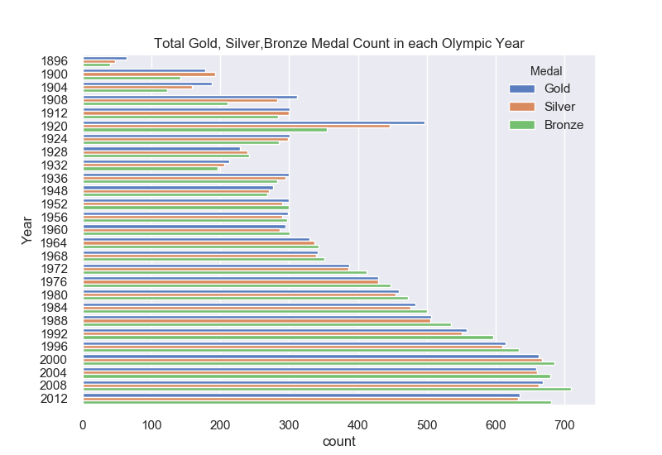
Total number of Gold Silver,Bronze medal won over the Olympic history:-
Around 500 Gold medal won in 1920
From 1976 , more than 400 medals has won each year.
Medal crossed 700 mark in year 2008
Highly positive trend.

Slide 10
Sports AND Discipline added over the years

